Slide 1
Agent Based Modelling
MODELLING THE DYNAMICS OF POLICE DEMAND AND RESOURCING OVER SPACE AND TIME
Sedar Olmez, Daniel Birks, Alison Heppenstall and Thomas French

Slide 2
Agent Based Modelling?
An agent based model is a computational model that allows the user to simulate autonomous entities with various characteristics within a defined environment.
Agent name: Bob
ID: 2011923
Height: 2m
Hates: Cookies, Burgers, Trump..

Slide 3
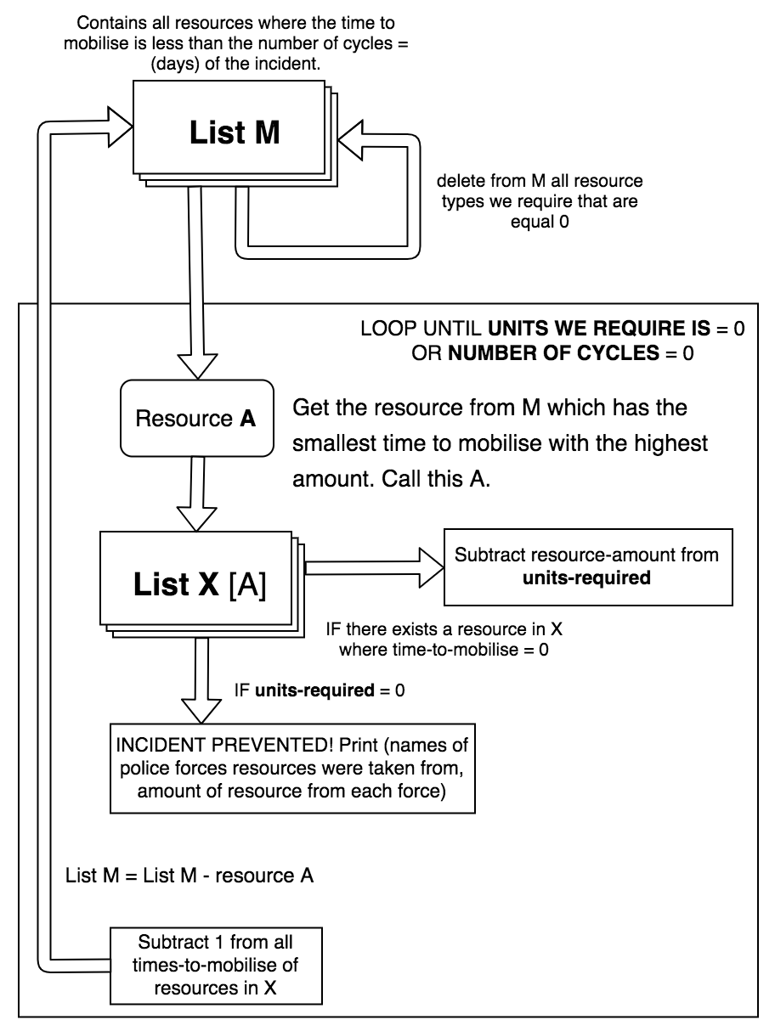

Slide 4
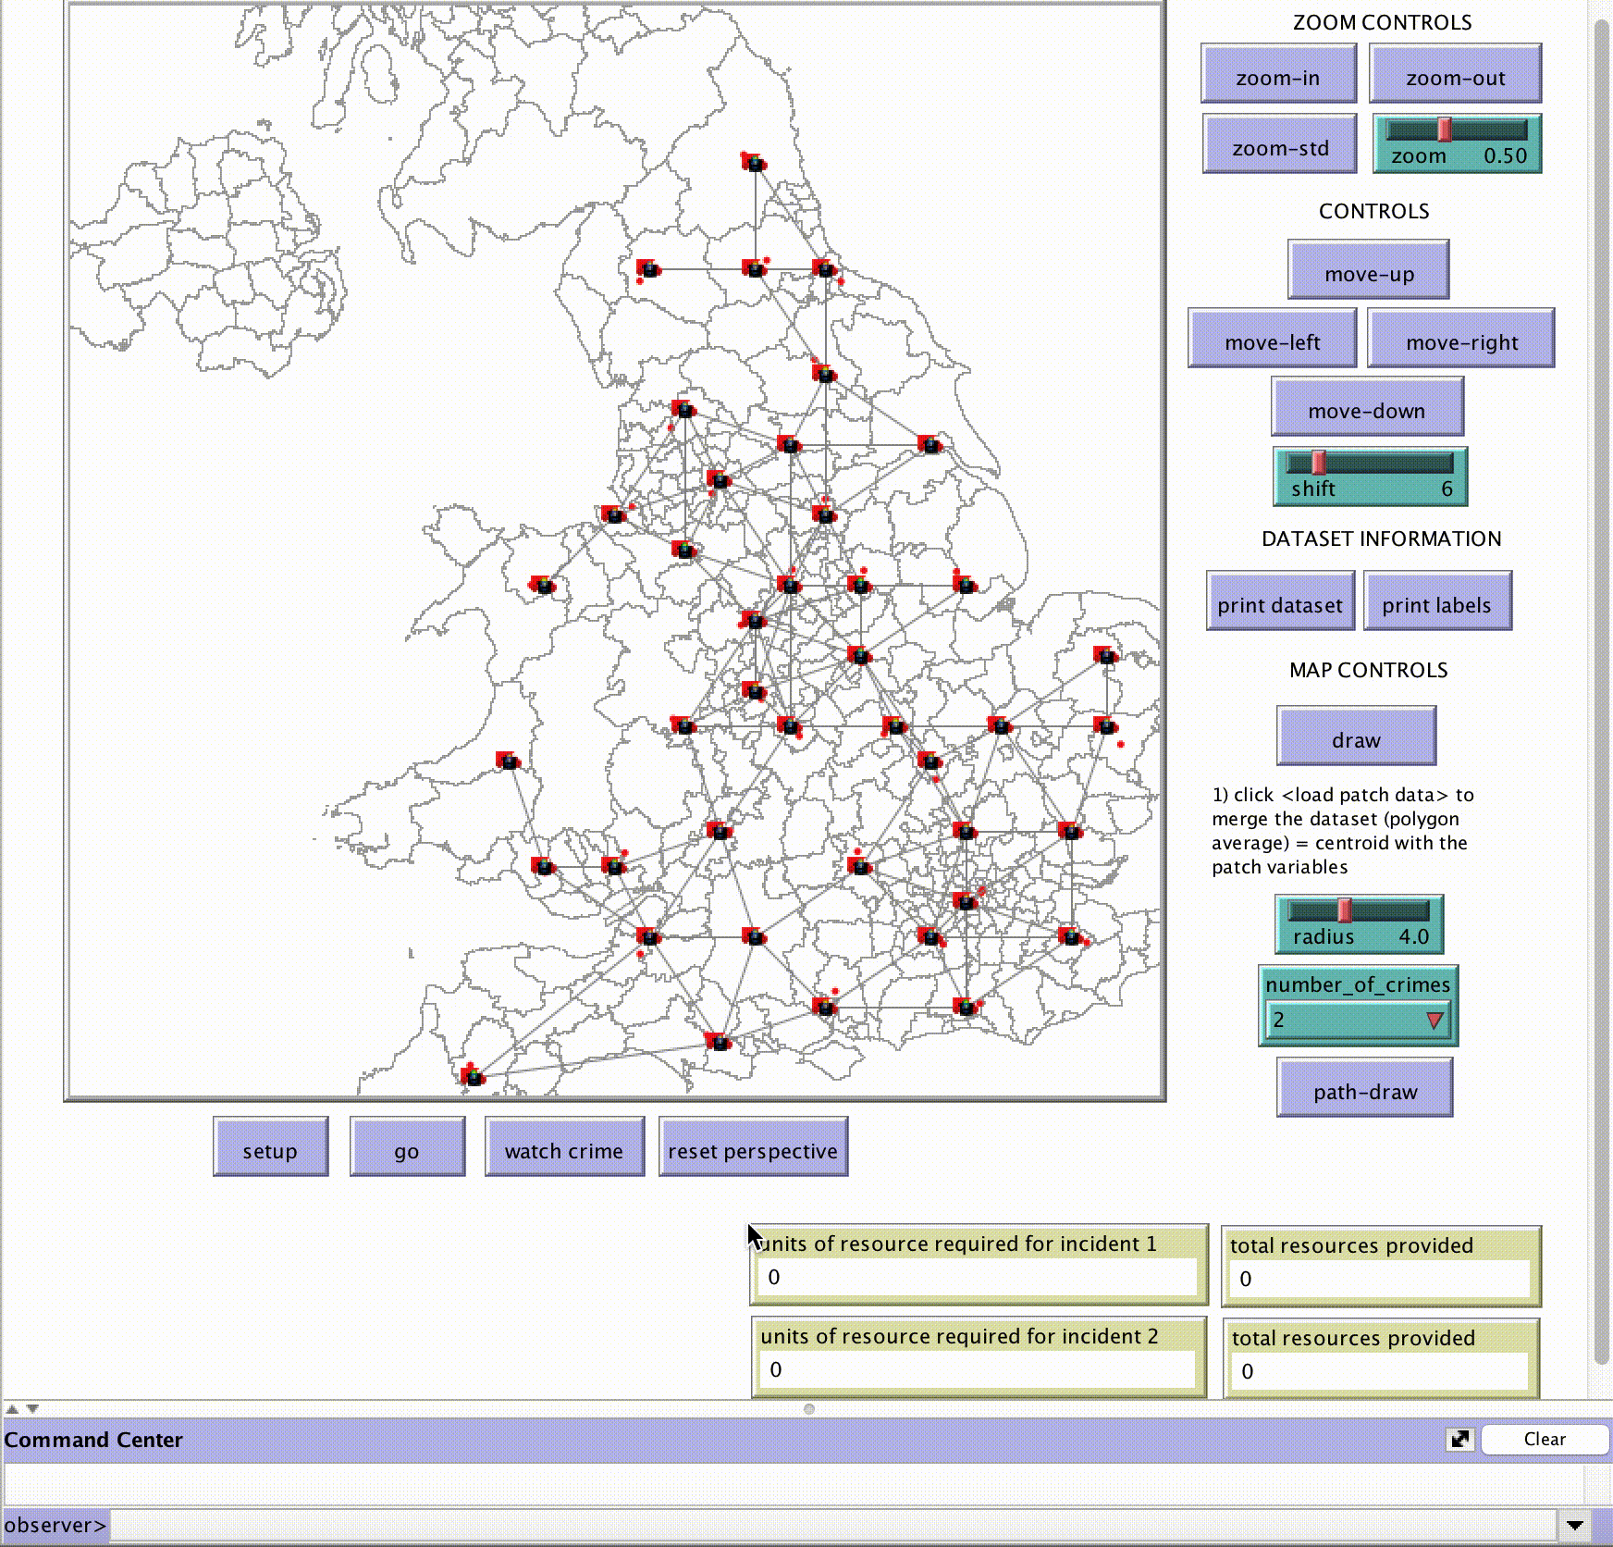

Model execution

Slide 5
Thank you!
SedarOlmez94
@SedarOlmez
../SedarOlmez94 -> police_simulation_project-PSP- -> tree -> master -> project

